Slide 1
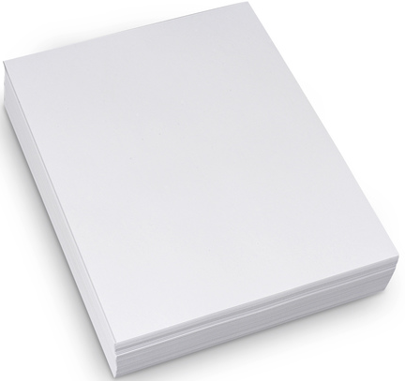
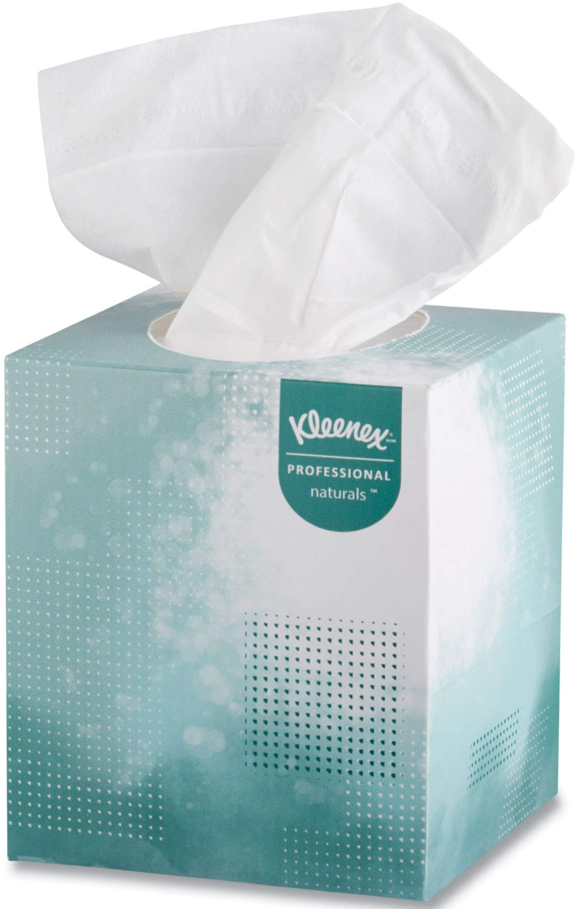
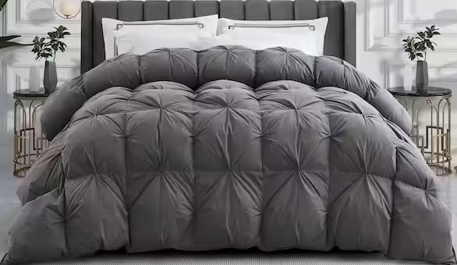
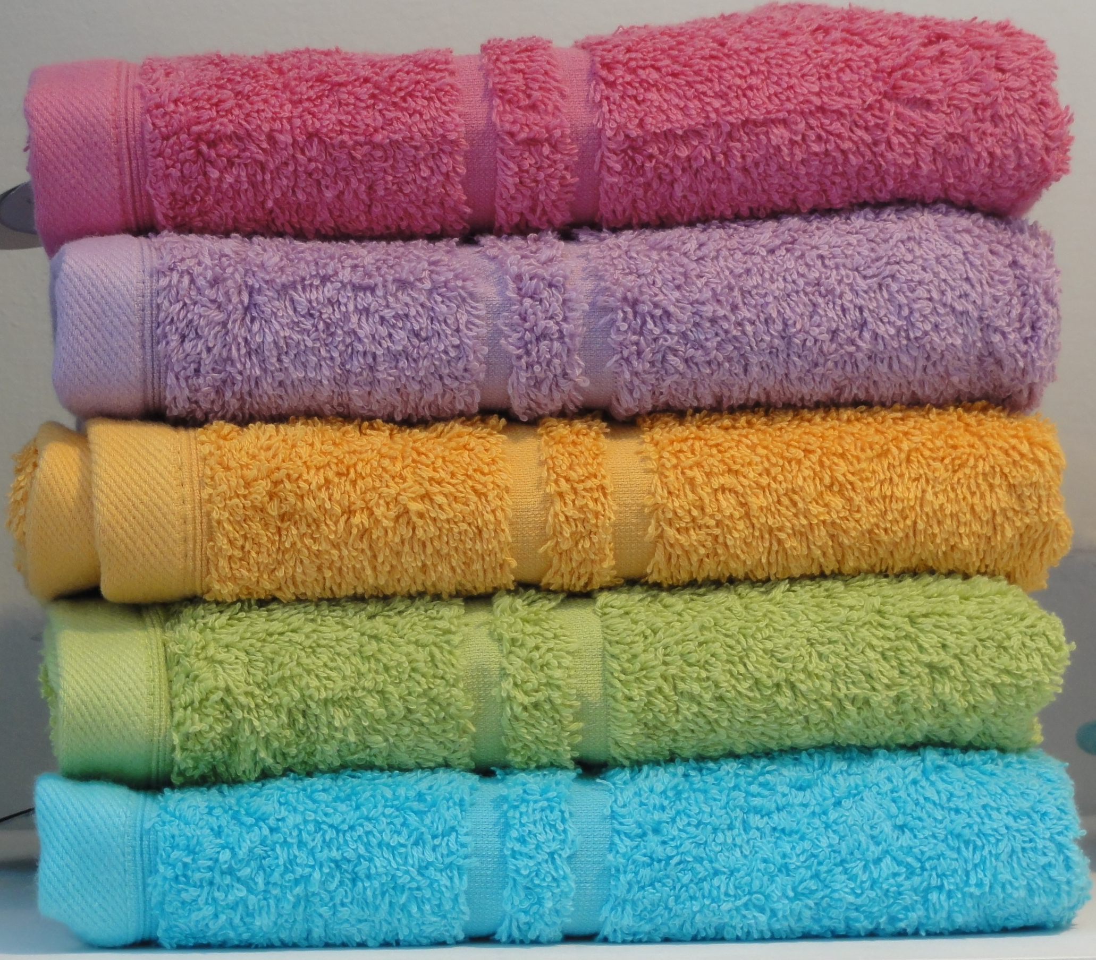
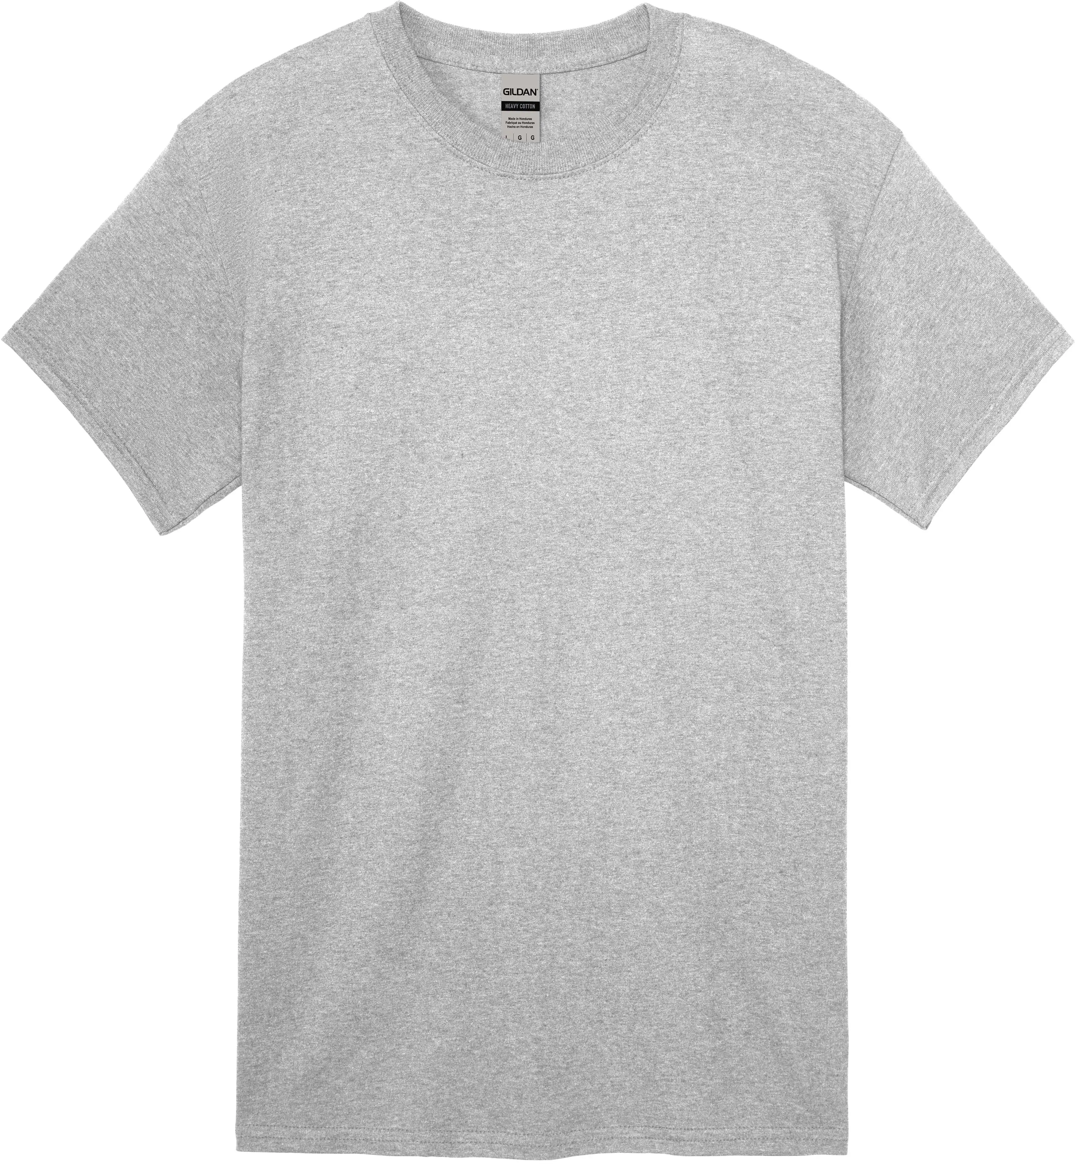
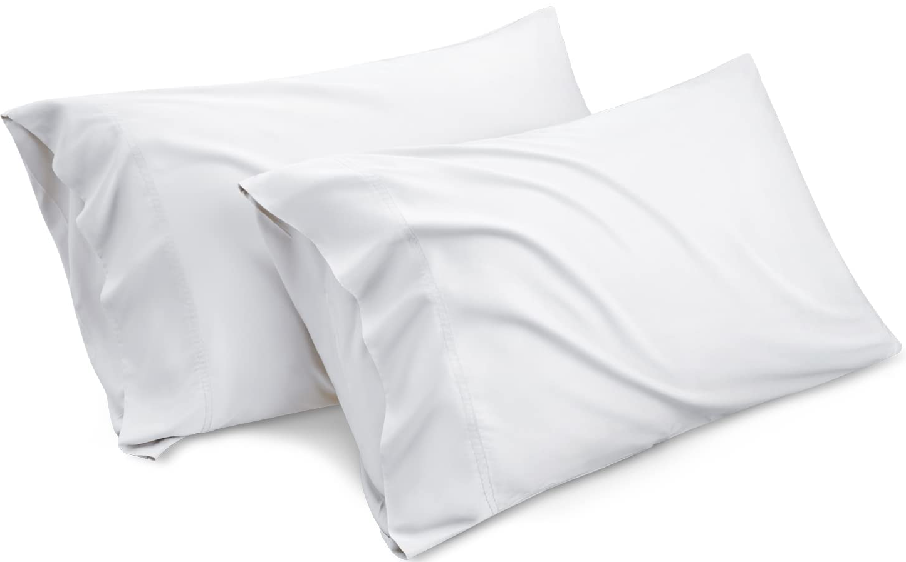
Printer Paper
Tissue Paper
Comforter
Towels
T-Shirt
Pillow
Lightweight
Heat retention
Environment Change, Bathroom Specialization
Endosymbiotic engulfing of feathers
Wood Fibers
Cotton Fibers
Fibrous Composition

